Slide 1


x
Smiling Gecko CSR
Initiative
2024

Slide 2
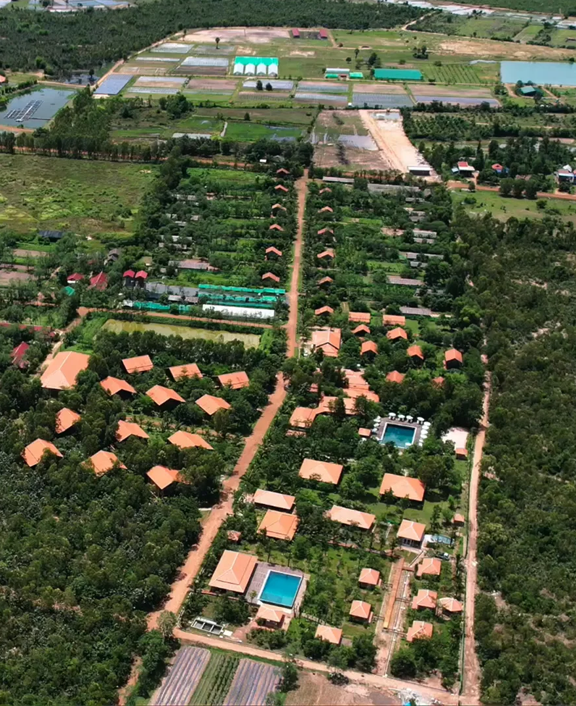






Enhance quality of life in rural Cambodia
Developing sustainable social enterprises
Delivering education and vocational training
Nurturing food security through a holistic approach
Foster resilience and drive lasting nationwide impact
Purpose &
Vision

Slide 3
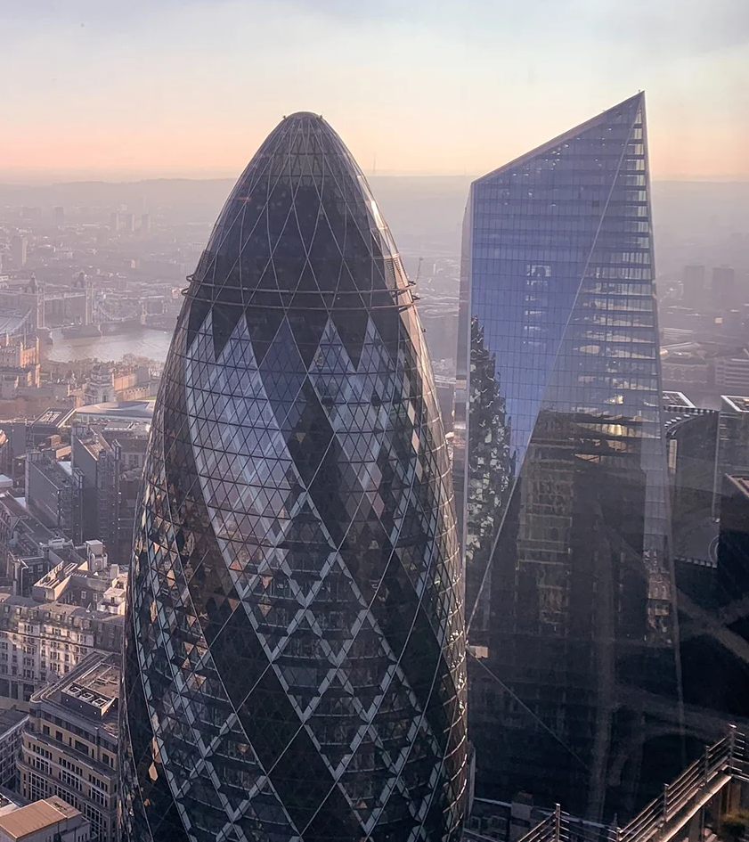





Driving Change Together
Focus funding areas of Smiling Gecko
Benefits for businesses
Tailored service offering
Create meaningful, sustainable impact
Strengthen and elevate CSR campaigns
Target
Audience
Employment | Education | Community | Basic Needs | Agriculture

Slide 4
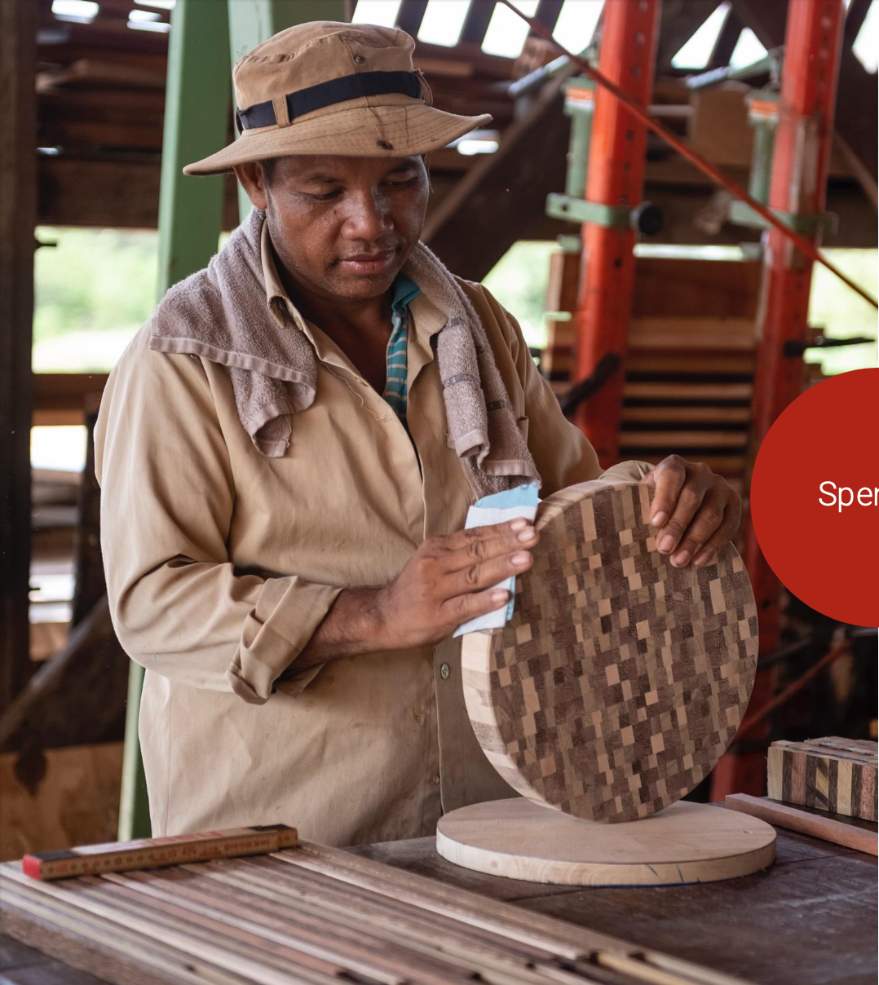

Economic
High poverty rates, with over one-third of Cambodians living on less than $2/day
Social
29% of 15-24-year-olds have not completed primary education in Cambodia
500’000 children in Cambodia grow up without their parents
The
Problem
Environmental
Unsustainable agricultural practices and biodiversity loss

Slide 5
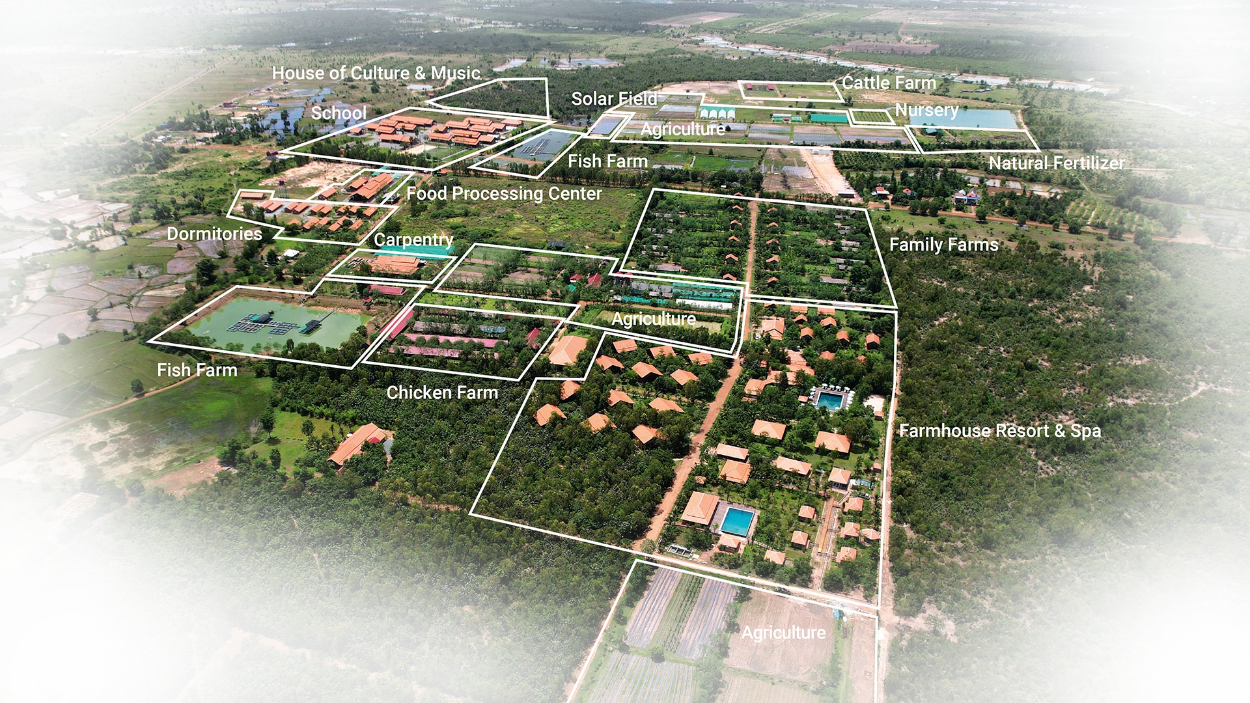
Smiling
Gecko
Campus
Craftsmanship & Production
Food Security & Sustainable Agriculture
Educational Development
Emergency Relief & Basic Needs
Community Development & Employment

Slide 6
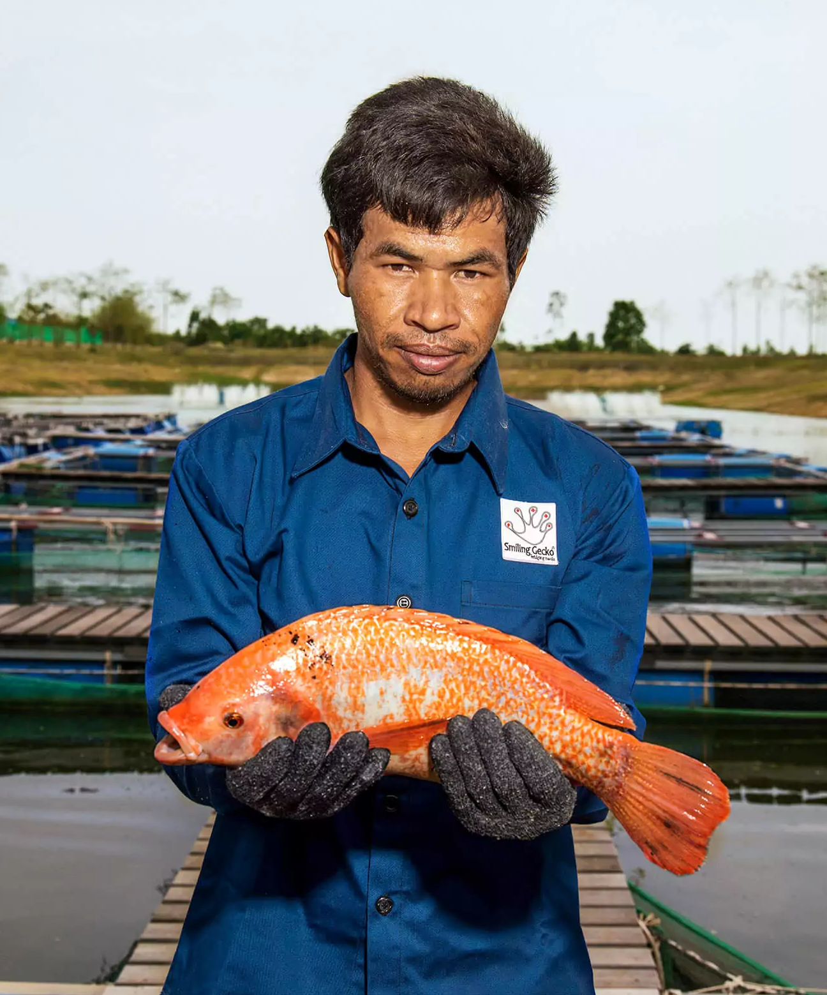

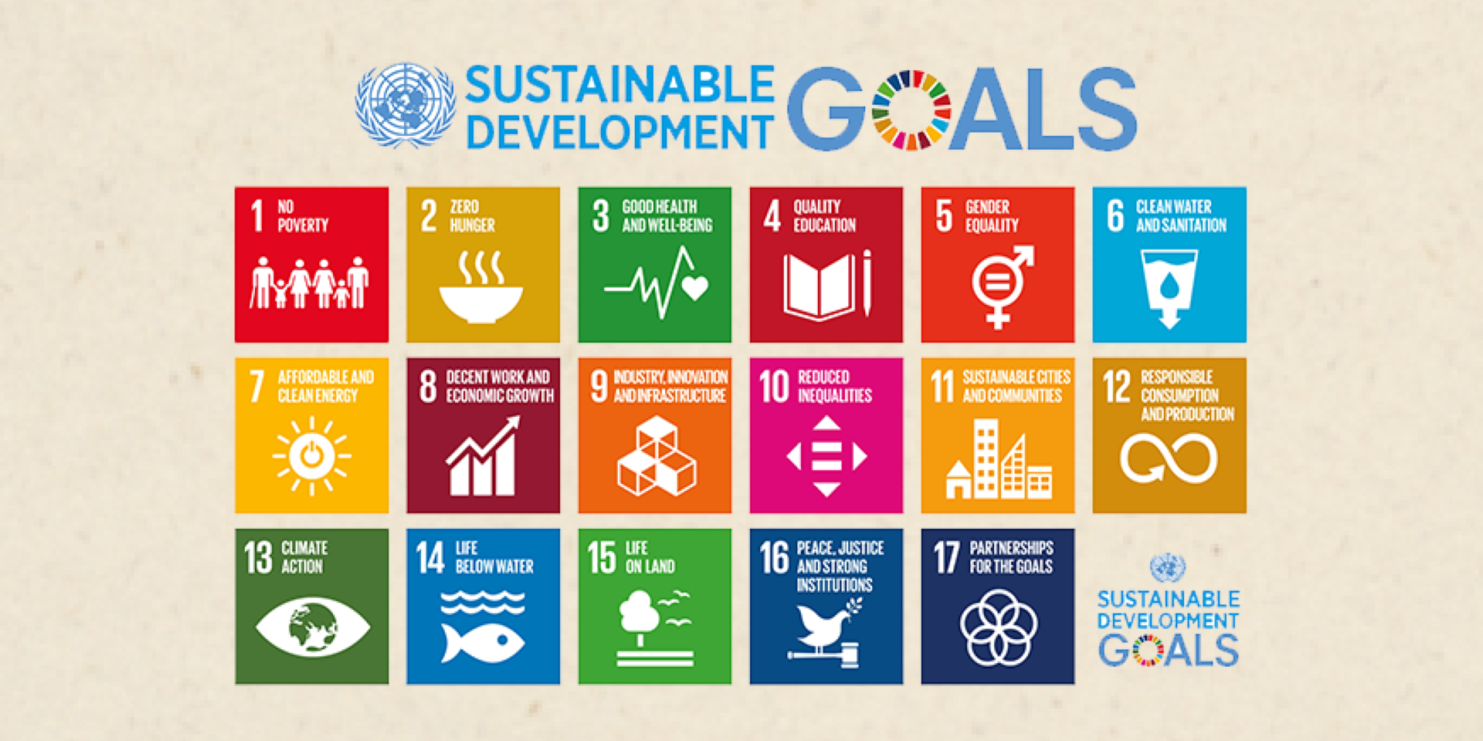

The Project
Local Fish Farm
Food Security & Sustainable Agriculture
Establishes local fish hatcheries and grow-out farms to produce high-quality tilapia
Funding need
20’000 $ commitment each year
Funding
Gap
The Problem it resolves
Circular economy by integrating organic farming and fish production
Improving both food security and farmer incomes

Slide 7
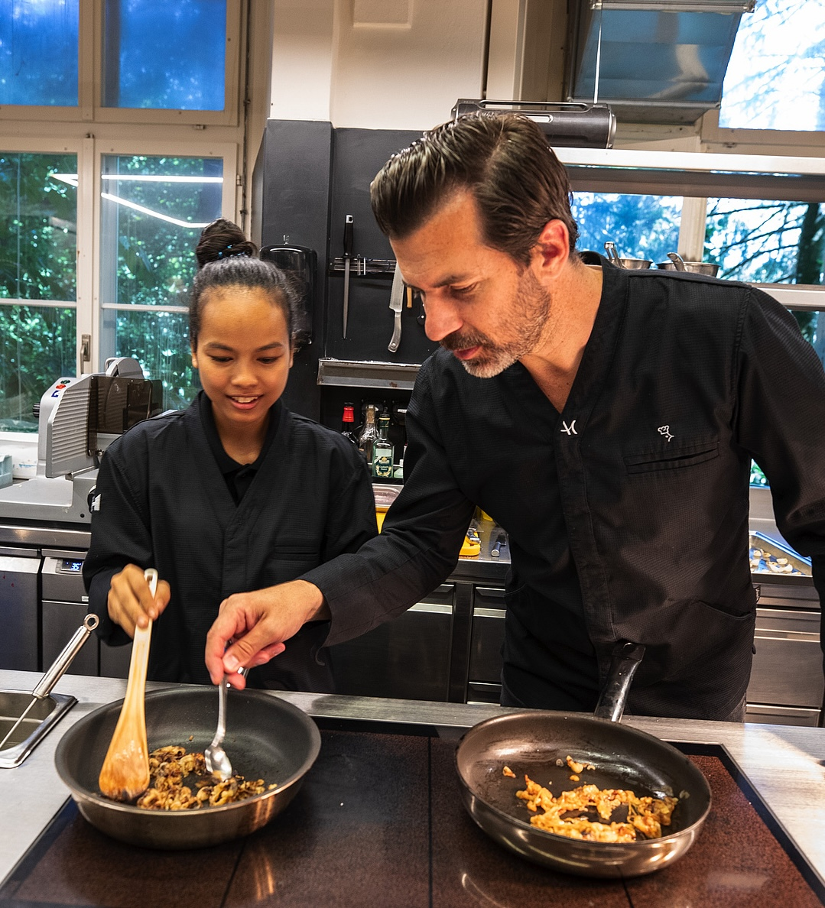

If you want to help us,
We will help you
Professional Video and Photography Content
Live Speaker Sessions with Smiling Gecko representatives
Interactive Cooking Workshops featuring chefs from Cambodia
Regular Reporting with KPIs and progress updates
Campus Tours and stay in the Farmhouse Resort & Spa
Self-Promotion Initiatives to boost visibility and impact
A Service
for your
Company

Slide 8
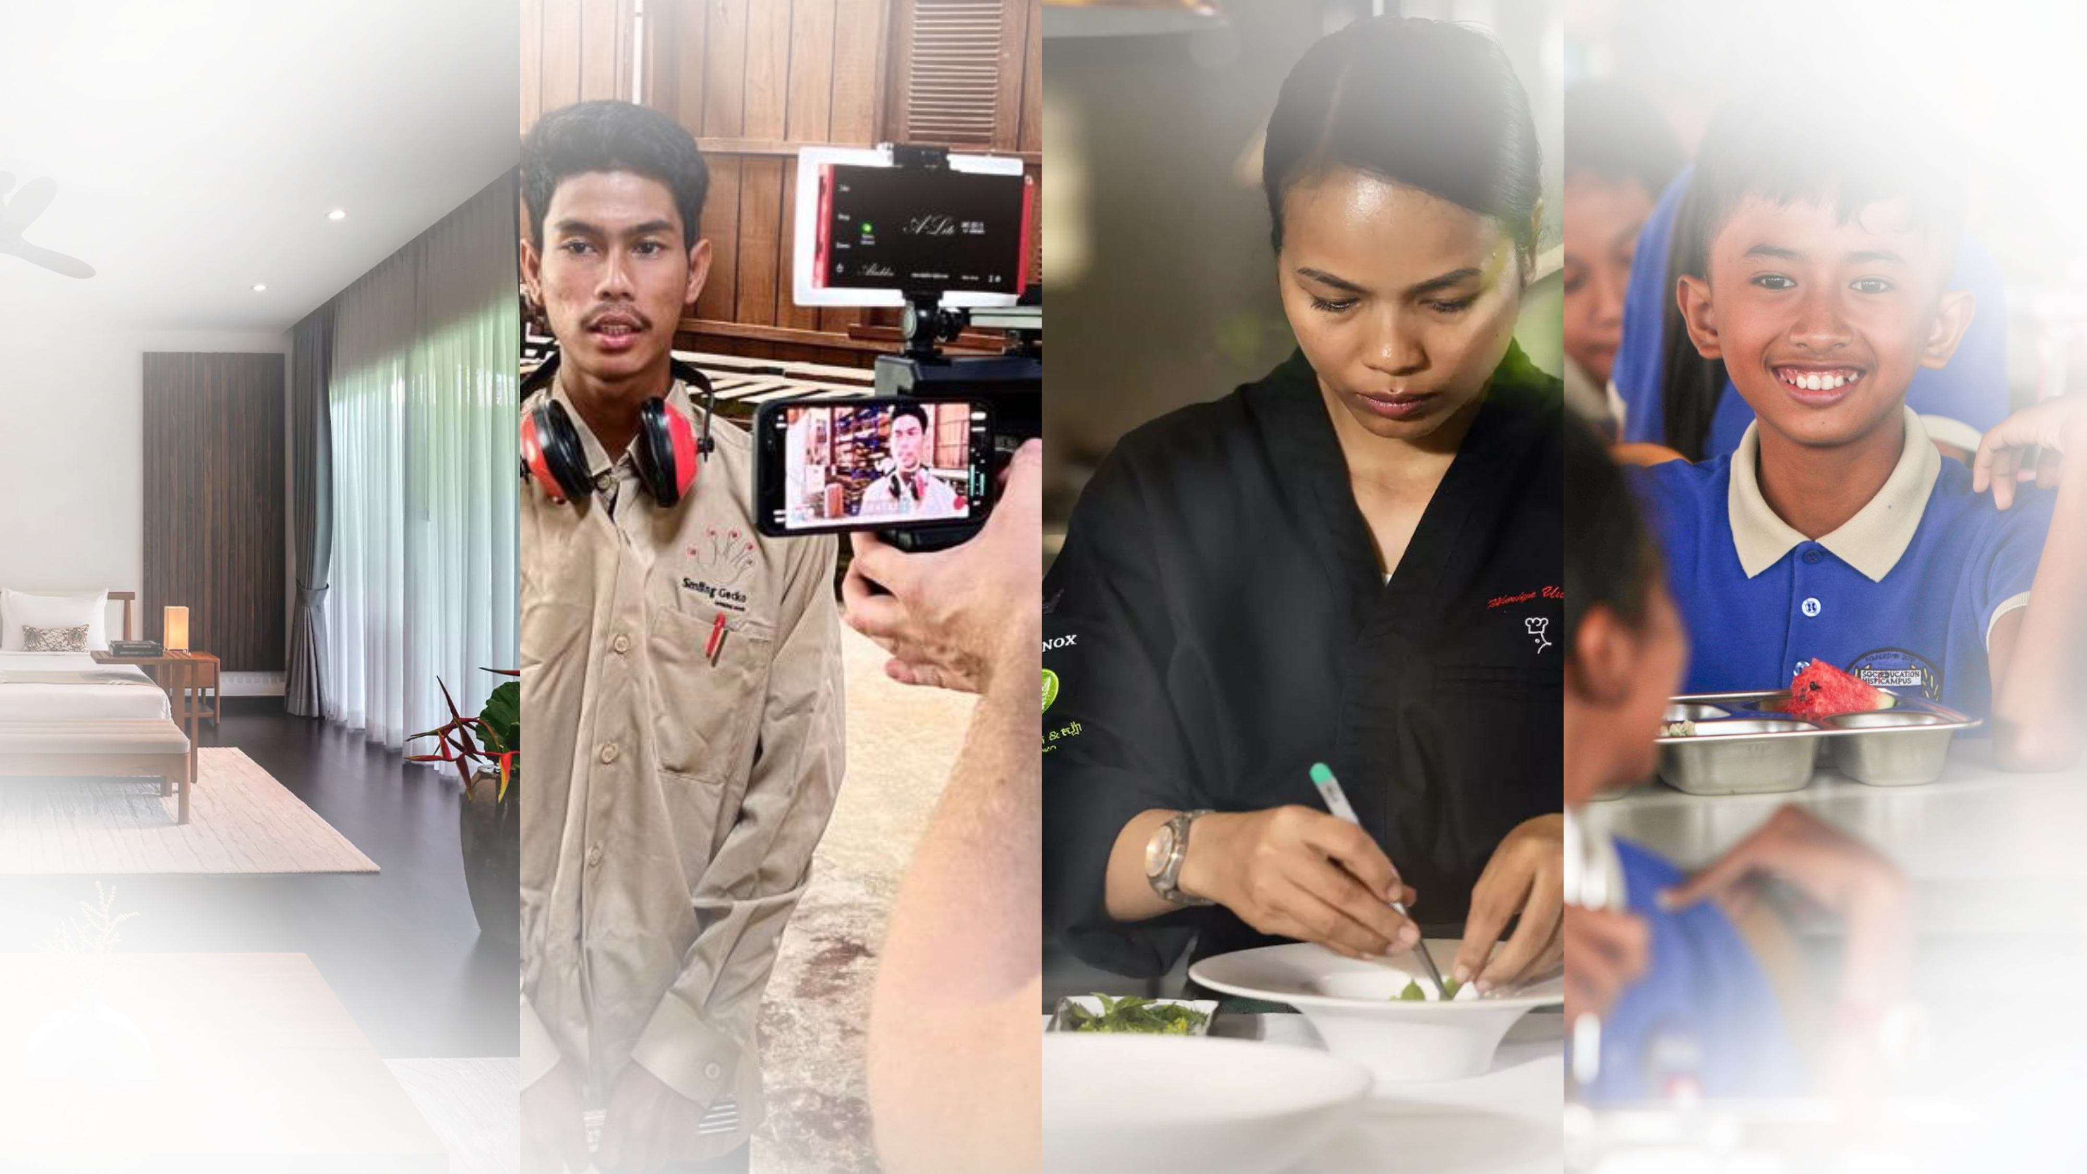
A Service
for your
Company
Farmhouse Resort
& Spa
Professional Video Content
Cooking Workshops with our chefs
Testing your newest products on campus

Slide 9
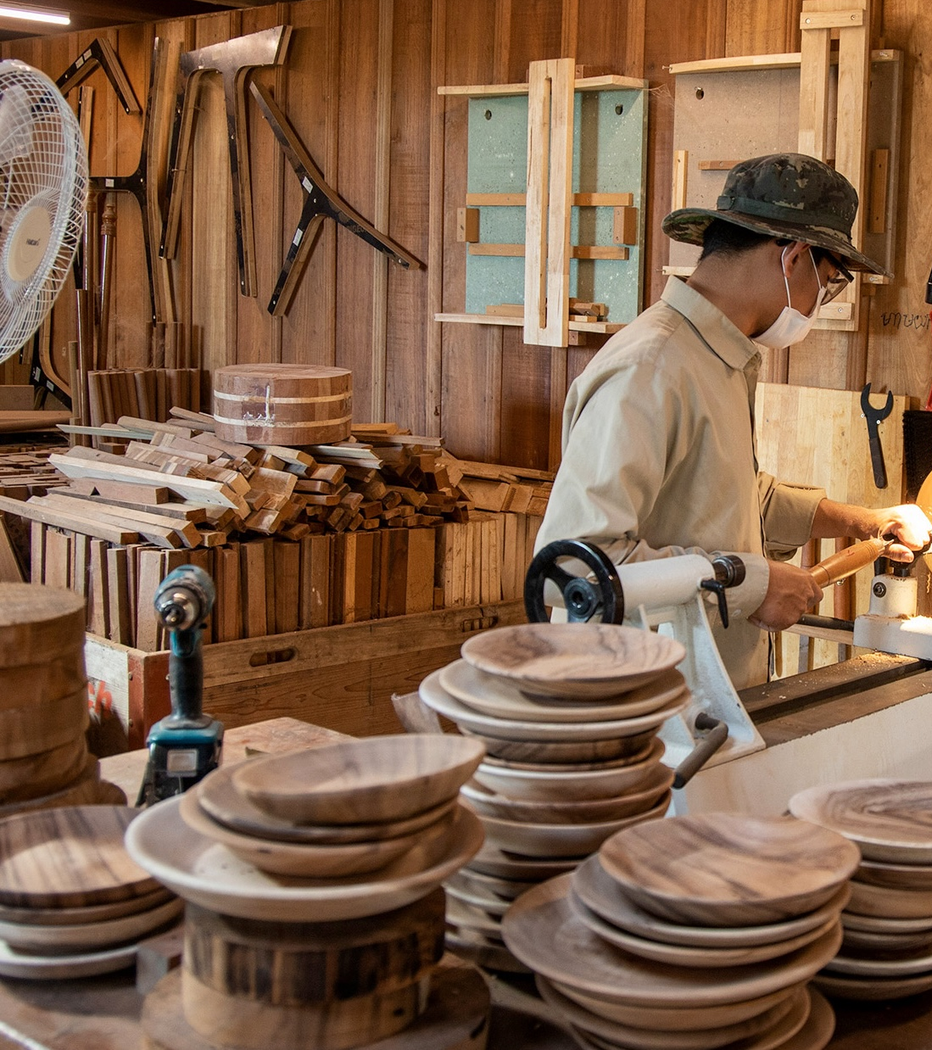

Self Sufficieny
The aim is to generate revenue for the entire business while attracting external investments to scale and replicate the model
Commercial
Model
2
Social
Enterprise
1
3
Company
NGO

Slide 10
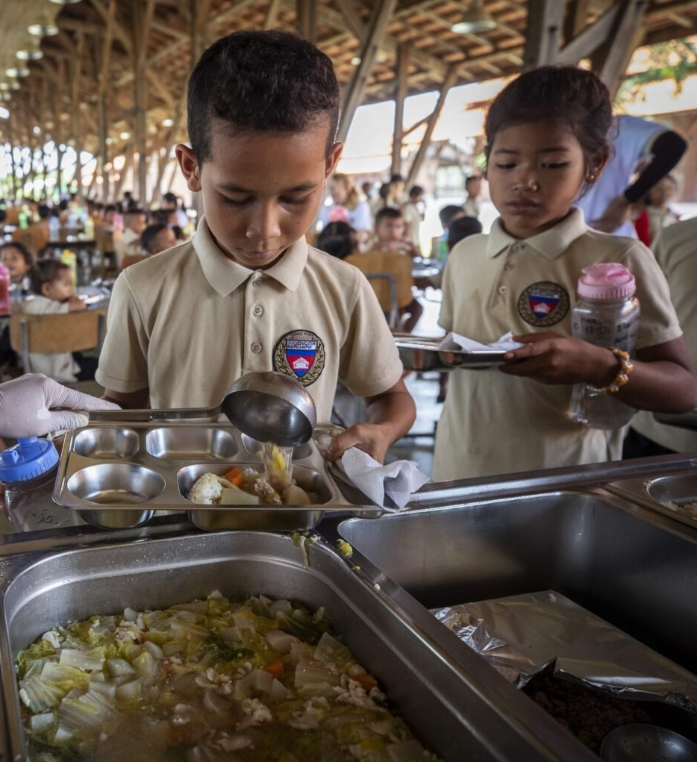

Building a Future for
Cambodia
470
children are going to school at the Smiling Gecko campus
50
more students every year are planned, ensuring continuous growth and opportunities
Innovative initiatives like the Farmhouse have already achieved self-sufficiency, paving the way for sustainable progress and empowerment
Evidence of
Success

Slide 11

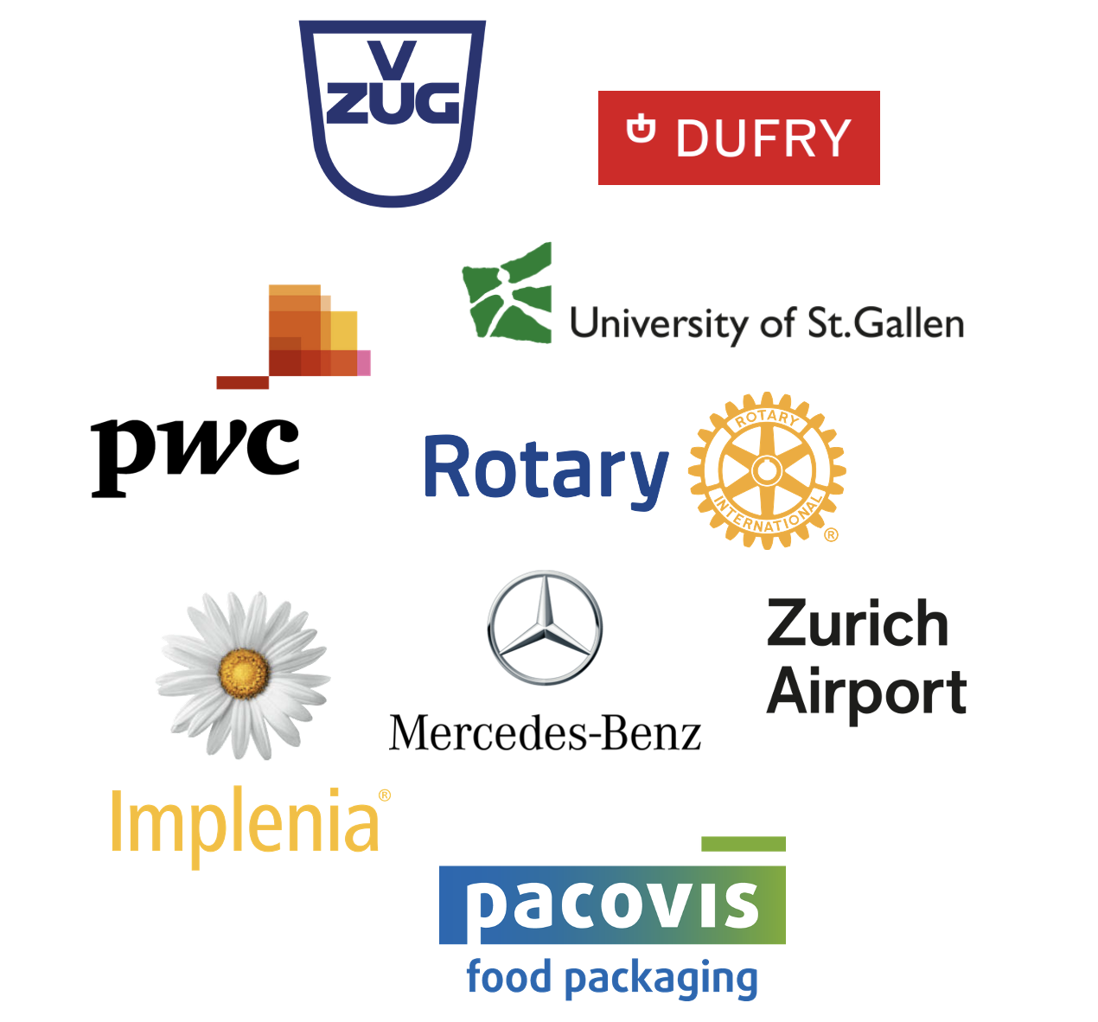
Organizations in Switzerland that have already successfully integrated Smiling Gecko into their CSR activities

Slide 12
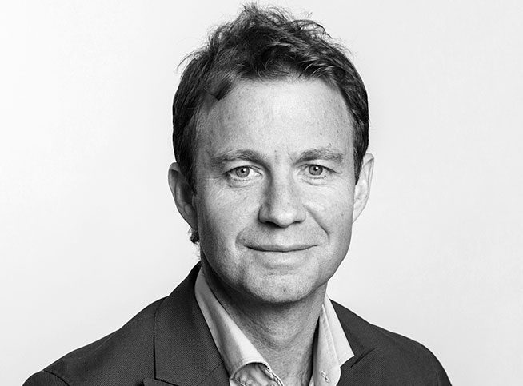
Your Contact at Smiling Gecko
Alain Biner
Telefon: +41 44 321 67 70
E-Mail: biner@smilinggecko.ch

